Slide 1
Boosting Algorithms
Ada Boost Algorithm
XG Boost Algorithm
LG Boost Algorithm

Slide 2
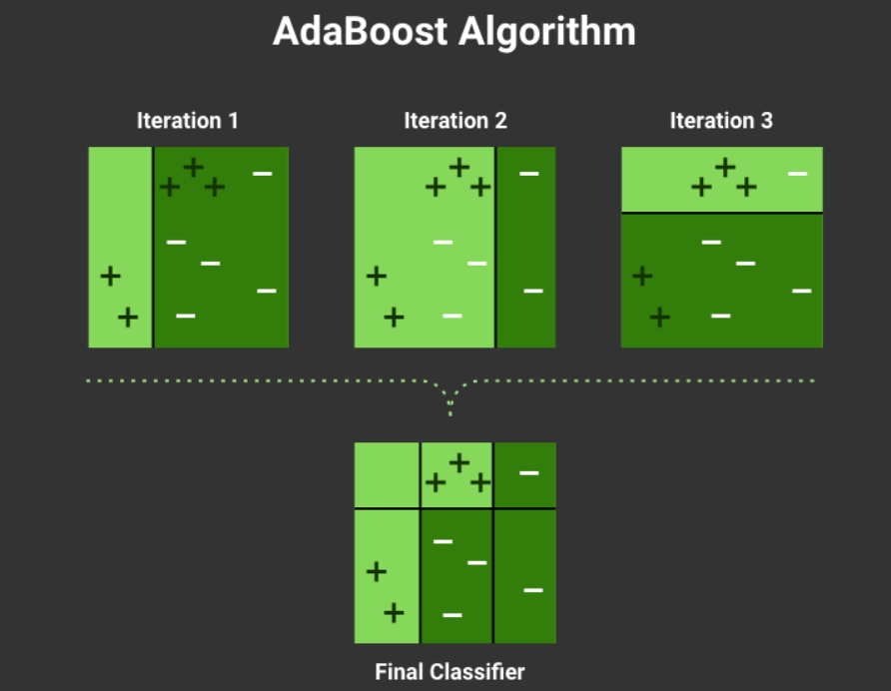

Slide 3
What is boosting? Ensemble technique where you create a strong classifier from a series of weak ones.
What is weak classifier ?
It is classifier that achieves accuracy, just above random guess accuracy.
Ex: For binary classification problem, it is 50% accuracy.

Slide 4
How boosting works?
Build a model on a training dataset.
Build a second model to correct the errors from the first model.
Build the next model until.
From the picture We used iteration 1, iteration 2, iteration 3 to build the model. After finding the correct errors from all the model. Combine every iterations to create final classifier model for this algorithm. We boosted the final algorithm from the all iteration model.

Slide 5
XG (Gradient Boost)
It builds many decision trees sequentially where each new tree ties to fix the errors of the previous once.
Features:
Regularization
Handles missing values automatically
Parallel processing
Works very well on structured/ tabular data

Slide 6
LightGBM or LG Boost
Boosting framework build by Microsoft
Also builds trees sequentially, but uses a more efficient method to grow trees.
Jumps to fix the biggest mistakes first
When working with large datasets and need speed.

